Slide 1
Program logic – What is a program logic?
This will be explored in more detail in the next webinar led by the Evidence and Evaluation Support Team at AIFS.
Tuesday, December 7, 2021 – 1 – 2 PM AEDT.
A program logic is a visual representation of the resources and activities that make up the program and the changes we expect from them.
Program logics will provide evidence of how each service will achieve its outcomes and ensure the intended outcomes are appropriate.

Slide 2
Program logic – Requirements
Service providers are required to develop a program logic for each funded activity.
Service providers must submit their draft program logic by 31 March 2022
Service providers must submit their final program logic by 30 June 2023
This requirement applies to the following programs:
Budget Based Funded
Children and Parenting Support (CaPS) services
Family and Relationship Services (FaRS), including Specialised Family Violence Services
Family Mental Health Support Services.

Slide 3
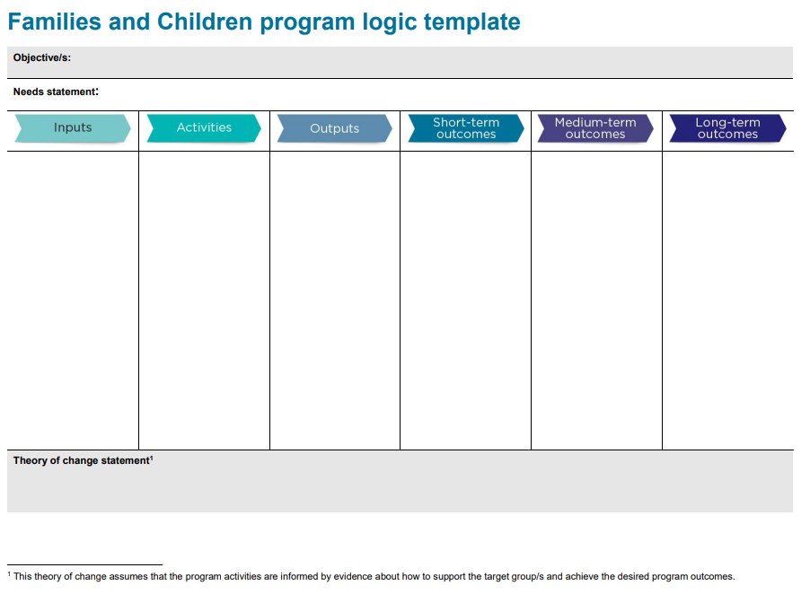
Program logic - Template
Program logic template and other support documents are available on the DSS website.
You may use an existing template if your organisation has one.
Multiple and single service.
Linkages with Activity Work Plans (AWPs).

Slide 4
Program logic - Process
Service providers must develop a draft program logic:
Use the department’s template (available on the DSS Website)
Examples have also been provided to assist providers to complete this requirement
Two example types: Multiple service and single service
Further support is available through FAMs, the Evidence and Evaluation Support Team at AIFS, and online resources
Check your funding agreement for your program logic milestones. In general these are:
Service providers must submit their draft program logic by 31 March 2022
Service providers must submit their final program logic by 30 June 2023.

Slide 5
Program logics - Assessment
Once you have submitted your draft program logic to your FAM, your FAM will assess this to ensure you have:
completed the template correctly and in full
used research and evidence
provided all the necessary information and included enough detail in each section
established a logical program pathway
included a theory of change statement
demonstrated accuracy and consistency with the objectives of the Families and Children Activity.
Where required, FAMs will provide feedback on draft program logics to service providers for action, with the goal of finalising the program logics by 30 June 2023.

Slide 6
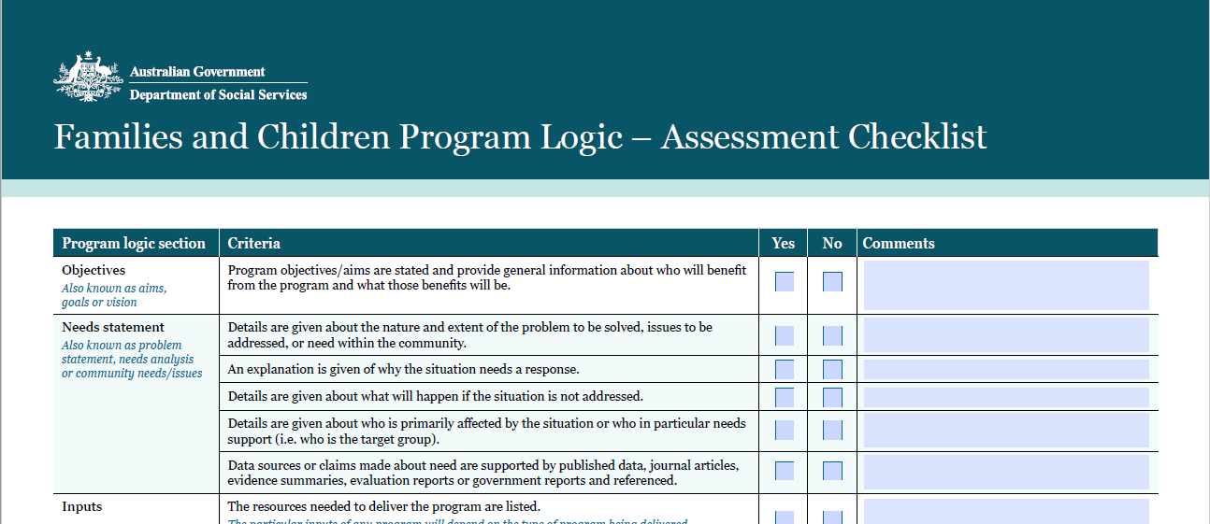
Program logics – Assessment Criteria
The department is finalising the assessment criteria resources and will publish and share these with service providers shortly.
DRAFT

Slide 7
Program logics – Useful resources
The department has provided a number of useful resources to assist service providers to develop their program logics. These include:
Guidance to complete the program logic (available in the template)
Examples of completed program logics
Assessment criteria (provided to you shortly)
Additional resources on the AIFS website (program planning and evaluation guide: https://aifs.gov.au/cfca/expert-panel-project/program-planning-evaluation-guide)
AIFS Evidence and Evaluation Support Team’s one-on-one support service at:
fac-expert-panel@aifs.gov.au
Your Funding Arrangement Manager.

Slide 8

Questions and Answers

Slide 9
Next program logic webinar
Tuesday, December 7, 2021 – 1 – 2 PM AEDT
In the next session, the AIFS Evidence and Evaluation Support Team will provide guidance on how to complete the new program logic template, followed by a Q&A.
The next session will cover:
• An overview of the purpose of program logic
• What is expected in each part of the template
• Tips and tricks
• Examples of program logics.
Register via the link in the AIFS newsletter.

Slide 10
Wrap-up
Many FaC Activity service providers are required to submit a program logic for their funded programs:
Draft program logic by 31 March 2022
Final program logic by 30 June 2023
Program logic template and examples can be found on the DSS website
The program logic assessment criteria will be made available to you shortly.
If you have any questions, register for the next webinar or contact your Funding Arrangement Manager to discuss.

Slide 11
Thank you
Family Policy
families@dss.gov.au

